Slide 1


Incognito
PROBLEM - 5
Health Insurance Application

Slide 2


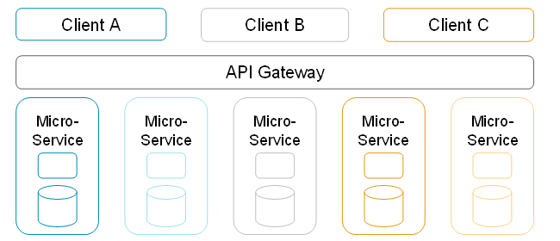
MICROSERVICE ARCHITECTURE
Benefits
Partial Deployment : Independent service can be separately deployed without redeploying the entire application.
Better Scalability : Each microservices can be independently scalable.
Better Agility : Microservice are independent which helps in scaling and upgrading service within limited time.
Software stack (Different software) : Each service can be developed with different technology stack. Easy Adoption to newer technology.
Polyglot persistence (Different DB) : Each microservices can be developed with different database as per business.
Limitations
Complexity: Microservices architecture is a distributed system with multiple modules and databases hence connections have to be handled carefully.
Consistency : Data consistency and transaction management becomes harder as each service has a database.
Test Automation: Increased demand for automation, as every service should be tested and monitored.
04

Slide 3
APPLICATION CHARACTERISTICS
Microservice application
Microservices are Independently Executable, Upgradable , Replaceable and Scalable
Domain specific features – Achieve Single Responsibility Principle
Light-Weight , Independent, Loosely Coupled business unit
Owns Codebase, Managed, Developed by a small team.
Own their Database – Decentralized Data Management
Choose Best Technology Stack - Evolutionary Design
Test, Release, Deploy, Scale, Integrate, and Maintain Independently – Own Devops Plan
Smart Endpoints and Dump Pipes - REST over HTTP or asynchronous messaging
Recovery and Fault Tolerance – Auto Healing Capability
More Effective , Efficient Deliverables and Customer Focused

Slide 4
TECHNOLOGY USED
Reacts – User Interface
Spring boot2 – Service Side
Nginx – Webserver & Reverse proxy
Netflix Zuul - API Gateway
H2– In-Memory Database
Centralized Configuration – Git Hub
Eureka Dashboard - Service Monitoring + Authentication
Docker Images – Docker Hub
Nexus Repository – Repository Docker Image
Swagger – API Specification
Netflix Hystrix - Fault & Latency Tolerance
04

Slide 5
MICROSERVICES - PURPOSE
MICROSERVICES | PURPOSE
COMMON-APIGATEWAY | Edge Service proxies requests to multiple backing services
COMMON-DISCOVERY-SERVICE | Register and Governance Service
COMMON-CONFIGURATION-SERVICE | Centralized Configuration
COMMON-PREMIUM-API | Premium Calculator Service
PAYMENT-SERVICE-API | Payment Service
04

Slide 6
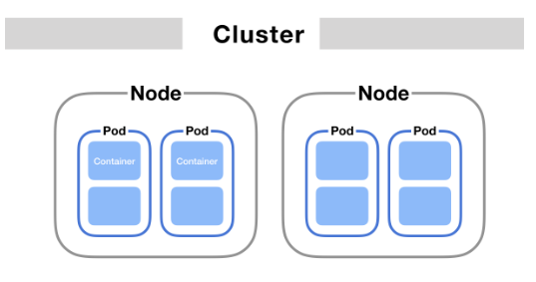
DEPLOYMENT PATTERN
SERVICE PER CONTAINER
Package service - Docker container image (Lightweight)
Deploy each service instance as a container
Docker Clustering Framework – Kubernetes
Orchestration Tool
04

Slide 7
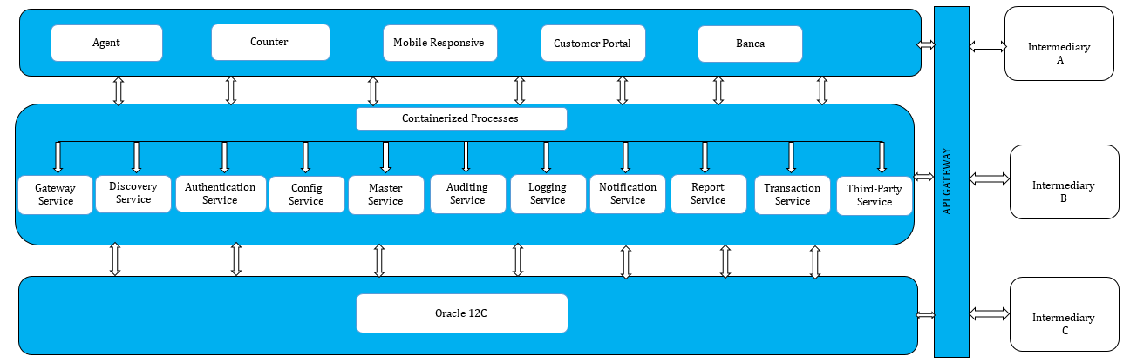
HIGHLEVEL ARCHITECTURE
04

Slide 8

KG Information Systems Private Limited
THANK YOU
www.kgisl.com

